Slide 1
DOT Data Overview
Data Innovation DC
D. Morgan
27 May 2015

Slide 2
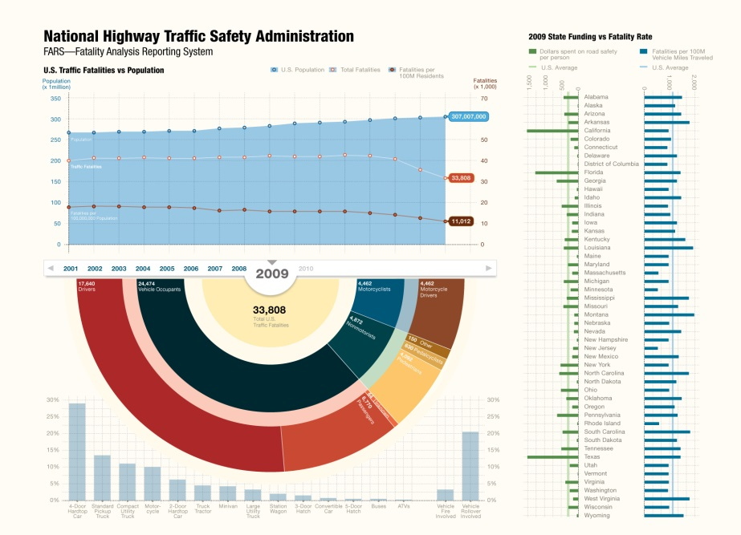
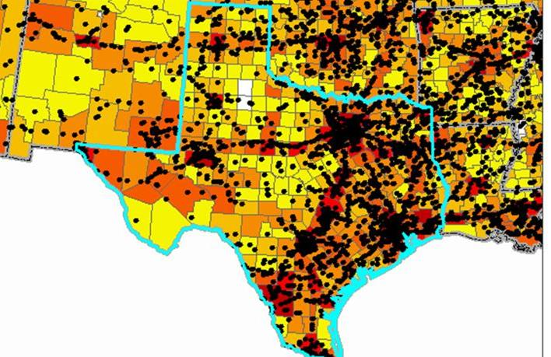
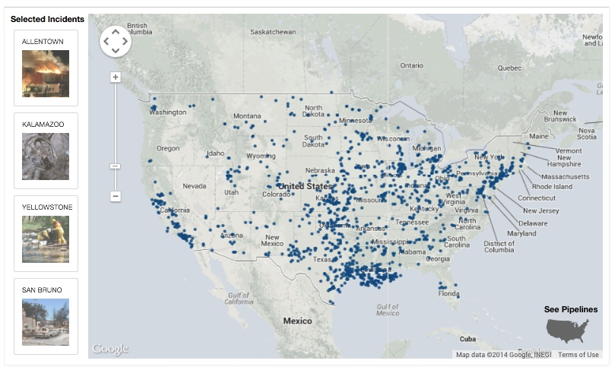
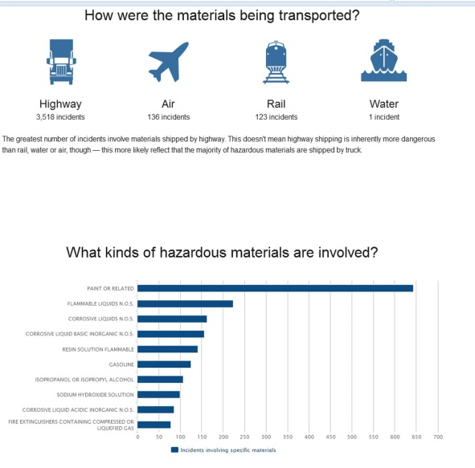
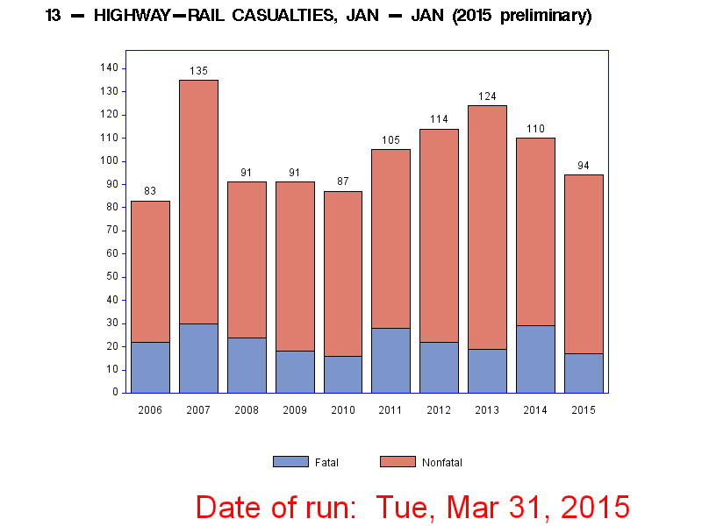
Safety
Fatal Roadway Crashes
Highway-Rail Accidents
Trespasser Casualties
Large Truck Crashes
Pipeline Incidents
HAZMAT Incidents

Slide 3
Where to get safety data
Railroad Safety
Downloads: http://safetydata.fra.dot.gov
Trespasser Casualty Map: http://fragis.fra.dot.gov/Trespassers/
APIs: https://safetydata.fra.dot.gov/MasterWebService/FRASafetyDataAPIs.aspx
Large Truck & Other Motor Carrier Crashes
Downloads: https://ai.fmcsa.dot.gov/SMS/Tools/Downloads.aspx
Crash Query & Mapping Tool: http://ai.fmcsa.dot.gov/CrashStatistics/rptSummary.aspx
APIs: https://mobile.fmcsa.dot.gov/developer/home.page
Roadway Crashes
Download fatal crashes: ftp://ftp.nhtsa.dot.gov/fars/
Download crash estimates: ftp://ftp.nhtsa.dot.gov/GES/
HAZMAT Incidents
Search: https://hazmatonline.phmsa.dot.gov/IncidentReportsSearch/
HAZMAT Intelligence Portal: http://1.usa.gov/1Q8qRB2
Pipeline Incidents
Download: http://1.usa.gov/1F8nKmK
Context (all operator annual reports): http://1.usa.gov/1kPTSCQ

Slide 4
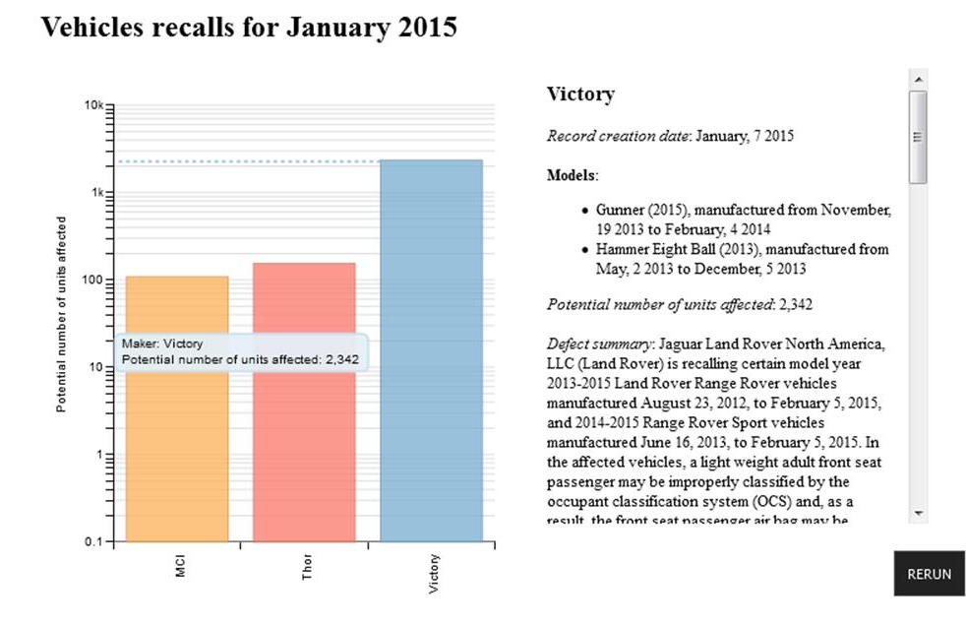
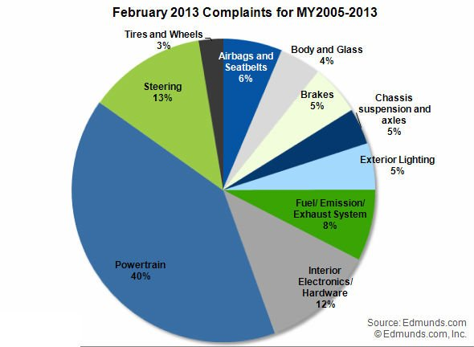
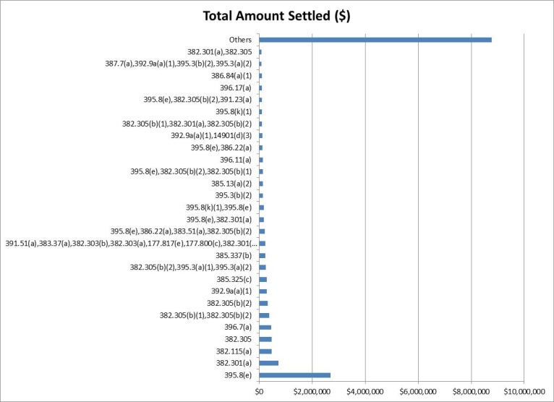
Enforcement
Civil Penalties
FAA
FRA
FMCSA
NHTSA
PHMSA
Recalls
Complaints
Drug & Alcohol Screening

Slide 5
Where to get enforcement data
Vehicle Recalls & Owner Complaints
Download: http://www-odi.nhtsa.dot.gov/downloads/flatfiles.cfm
APIs: http://www.nhtsa.gov/webapi/Default.aspx?Recalls/API/83
Civil Penalties
FAA: http://1.usa.gov/1FBmITD
FRA: http://1.usa.gov/1LFAV40
FMCSA: http://1.usa.gov/1Q8reeX
NHTSA: http://1.usa.gov/1PKwn2a
HAZMAT: http://1.usa.gov/1FN7sEy
Pipeline: http://1.usa.gov/1PKwwTf

Slide 6
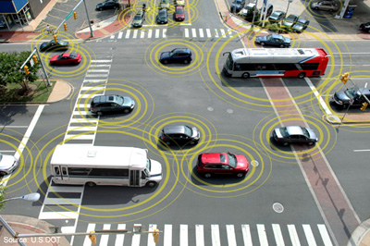
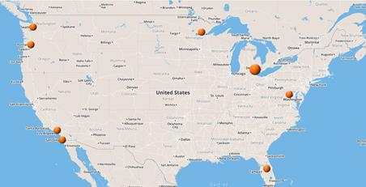
Connected Vehicle Research
Research-grade data from demonstration projects around the country
Vehicle Awareness Device Data (including network packet capture)
Related data (traffic, roadway network, weather)
Get it: https://www.its-rde.net/

Slide 7
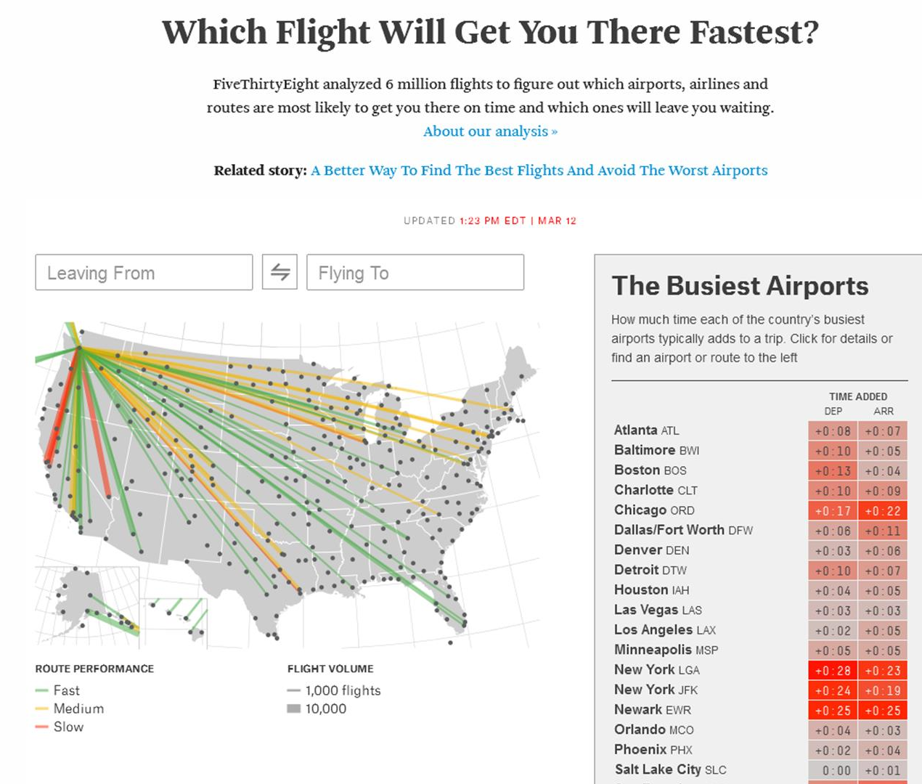
Airline Performance
Time-series data of airline performance
Get it: http://1.usa.gov/1esaS5e
Browse other airline performance and market research data: http://1.usa.gov/1IYaNmN

Slide 8
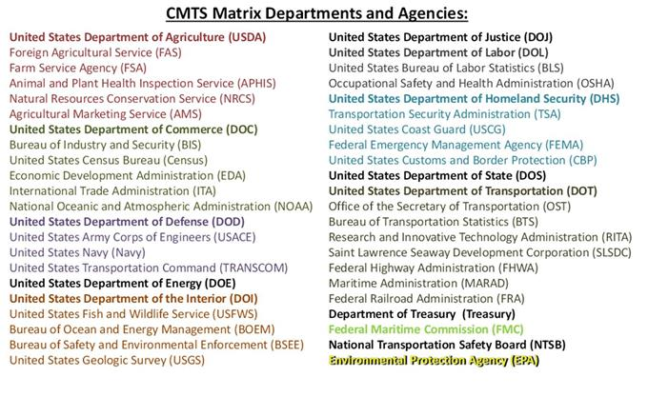
Maritime System

Slide 9

All the Data
http://catalog.data.gov/organization/dot-gov
Tweet me: @dsmorgan77
Email me: daniel.morgan@dot.gov

